Slide 1
French Railways in Pandemic and Non-pandemic Times: An Analysis
Analyst and Presenter: Je-Ching Liao

Slide 2
Introduction of Dataset
Source: Société Nationale des Chemins de Fer Français
(SNCF, French National Railways)
Link: http://bit.ly/regularite-mensuelle-tgv-par-liaisons
Size: 8,154 rows by 26 columns
Description: The dataset records the overall operations of SNCF trains from January 2018 to June 2023, with data including average travel time, number of scheduled trains, number of delayed trains (with respect to different degree of delayed time), average time of delay, percentages of delay due to different reasons, etc. Each row of data contains the monthly averaged information of one direction of a route.

Slide 3
Why This Dataset? What about it?
WHY: Previous experience of taking trains in Europe
Highly unstable departure and arrival status: constant delay and cancellation
Various reasons for delay: strike, railroad infrastructure, passenger
WHAT: Relationships between different features of data about trains
Between time periods in a year and performance of train operation
Between length or number of trains of a route and performance of operation for the route
Specific to this dataset:
Performance in pandemic times and non-pandemic times
Performance during lockdown and non-lockdown times within pandemic

Slide 4
Questions to be asked
How does the number of scheduled trains/percentage of delay fluctuate through time?
Does train punctuality vary significantly by season or month?
Does train punctuality differ with lockdown or without during pandemic?
The relationship between number of scheduled trains and percentage of delayed trains
The relationship between travel time and percentage of delayed trains
The relationship between travel time and average delay of all trains on arrival/at departure
Does a specific cause of delay happen more likely in certain months?
The correlations among different delay causes

Slide 5
Data preprocessing
Column names translated into English through DeepL
Three columns of natural language comments describing the delay dropped
High percentage of missing values
Lengthy description in French might lost the original meaning even if translated into English
New columns created: Percentage of trains delayed
By (Number of trains delayed/Number of scheduled trains*100)
In terms of different categories: at departure, on arrival, > 15min, > 30min, > 60min
Aggregated dataset created
8,154 monthly entries condensed into 65 direction-free routes
The aggregated data of each route is the original data averaged across both directions and different months

Slide 6
Data preprocessing details
Column names translated into English through DeepL
Three columns of natural language
High percentage of missing values
Lengthy description in

Slide 7
Data visualizations
Seaborn package of Python
Time related charts: lineplot()
Topic: Percentage of delay trains (15min+, 30min+ and 60min+), pandemic vs. non-pandemic
Original approach: draw all six trends in one graph
Result: overlapping lines; hard to see the comparison between pandemic and non-pandemic
Corrected approach: Three-subplot plot to give pairwise comparison
Relationship between data columns: regplot()
Topic: Percentage of train delay at departure ~ Number of scheduled trains
Original approach: draw all 8,154 data points on the scatter plot
Result: crammed up dots that take up entire space; hard to see a pattern
Corrected approach: use the aggregated dataset and put 65 dots on scatter plot to see clear pattern

Slide 8
strikes & Lockdowns
Could affect train operation drastically
2018 April-June French train strike
2019–2020 French pension reform strike
Spanned from December 2019 to February 2020
COVID-19 pandemic in France
Overall duration: January 2020 to February 2022
First lockdown: March 2020 to June 2020
Second lockdown: October 2020 to December 2020
Third lockdown: February 2021 to June 2021

Slide 9
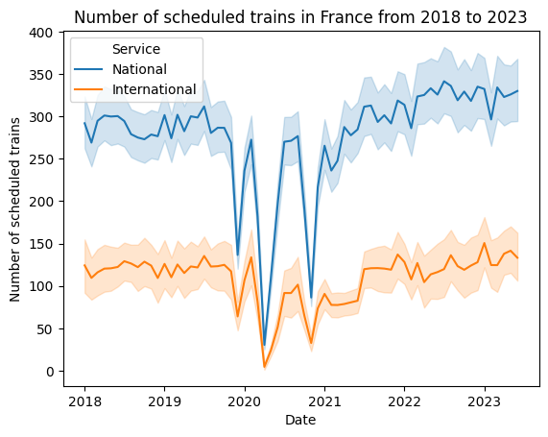
Drastic Drops throughout the years
Possibly due to strikes and pandemic lockdowns
2019-2020 strike and the first two lockdowns are accounted for
The third lockdown (2021/2 – 2021/6) saw rise in number instead
By intuition, fewer railway workers means fewer trains during strikes, while lockdowns means fewer travelers, the supply of train rides decreases accordingly
Relatively stable (domestic ~300 per month, international ~125 per month) excluding the three big fluctuations

Slide 10
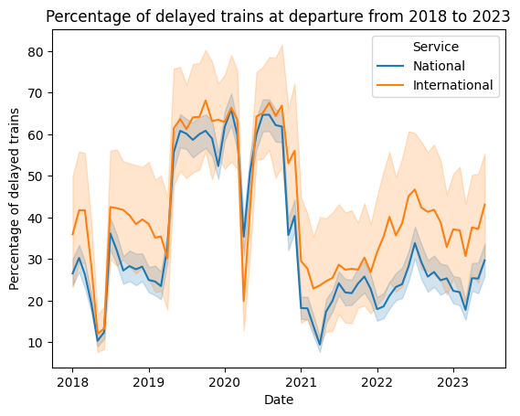
Delay at departure fluctuate greatly
Not stable throughout the years, might have more reasons
2019-2020 strike and the second lockdown coincide with the spike of trend, namely over 50% of the train delayed at departure
An overall growth starting from 2021 to 2023

Slide 11
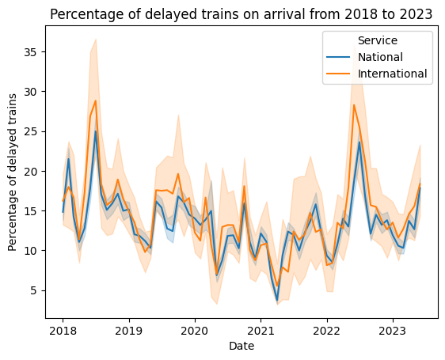
Delay on arrival lower during pandemic
Overall fluctuate within a smaller range and more on seasonal swing
The pandemic times (2020/1-2022/2) sees lower percentage of delayed on arrival on average
Bigger spikes (over 25% of trains delayed on arrival) coincide with the 2018 train strike and the start of the post-pandemic period (after February 2022)

Slide 12
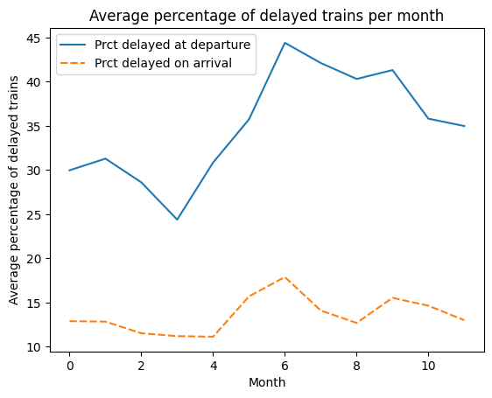
June sees the most delay, April the least
The trends of departure and arrival delays resemble each other
Using .groupby() on the Month column, the mean percentage of delayed train across routes and different years on each month is acquired
The percentage of trains delayed at departure leads that of trains delayed on arrival by at least 10 percent, at most nearly 30 percent
Almost 45% of departing trains in June would be delayed (highest in chart), while around 10% of arriving train in April would be delayed (lowest in chart)

Slide 13
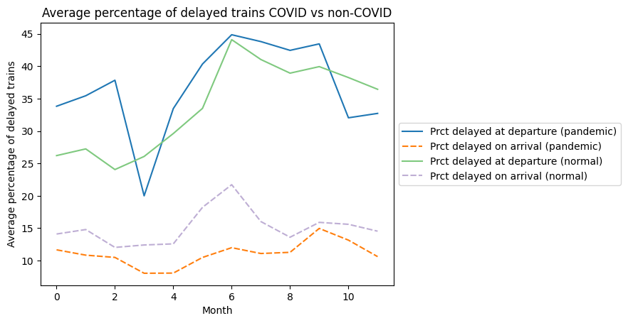
Departure and arrival different in COVID
Delay is worse during COVID times for departure, better on arrival
Using .loc() on the DateTime column, an isPandemic column is created to label each row into pandemic and non-pandemic times
Percentage of delayed trains at departure during COVID fluctuates more than that during non-COVID
Percentage of delayed trains on arrival during COVID is always lower than that during non-COVID

Slide 14
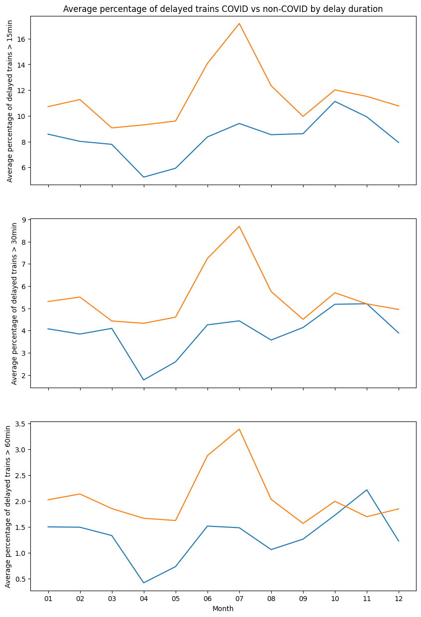
Better performance during covid
There are almost always fewer trains delayed for 15, 30, 60 mins or more during COVID than non-COVID
Orange is non-pandemic times, blue is pandemic times
The peak for non-pandemic times occurs during July, while the peak for pandemic times occurs during November

Slide 15
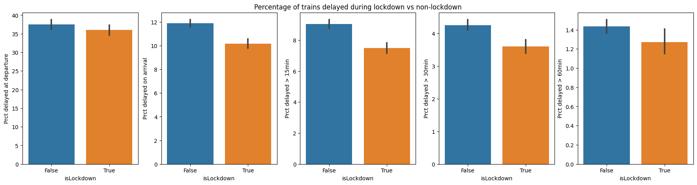
Lockdown means more punctual trains
During COVID times, trains during lockdown perform better in all measurement than non-lockdown
Using .loc() on the DateTime column of the sub-dataset with only data during pandemic, an isLockdown column is created mark rows that are in the three lockdowns aforementioned
All five barplots show a lower average percentage of delayed trains during lockdown than non-lockdown times in the pandemic

Slide 16
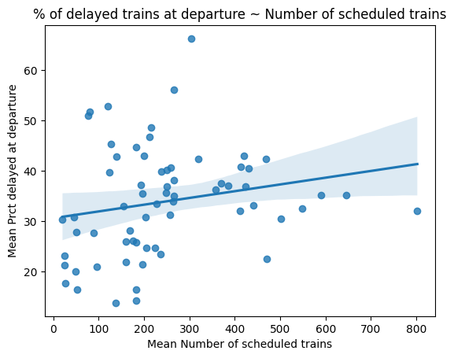
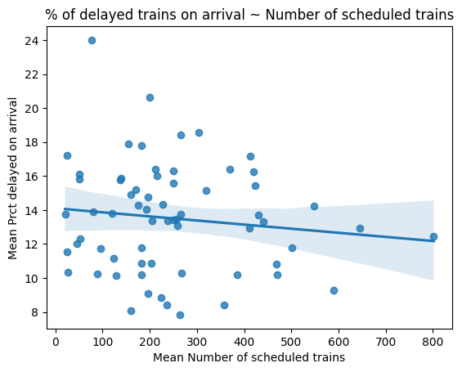
Number of trains Does not affect delay at departure/on ARRIVAL
Using the average data on 65 distinct routes, scatter plots and regression lines are drawn for mean number of scheduled trains being the predictor variable and mean percentage of delayed trains as dependent variable
Both chart as a flat regression line, hinted By ANOVA test, the p-value is 0.103 for the regression result for percentage of delayed trains at departure and 0.331 for on arrival. For a threshold of p-value = 0.05, we cannot reject the null hypothesis that number of scheduled trains has nothing to do with either of them

Slide 17
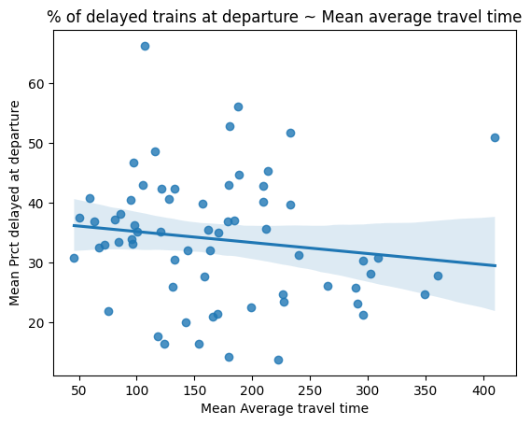
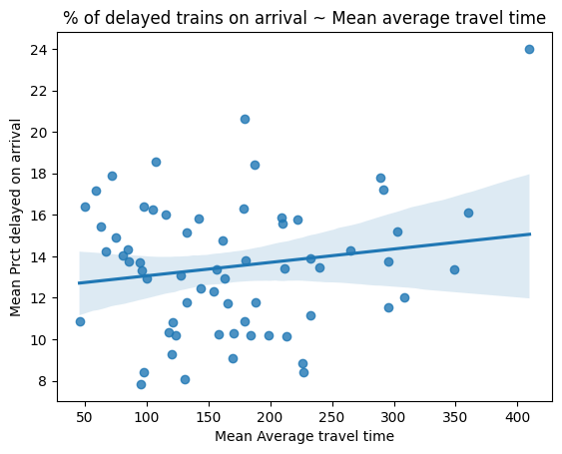
AVERAGE TRAVEL TIME Does not affect delay at departure/on ARRIVAL
Using the average data on 65 distinct routes, scatter plots and regression lines are drawn for average travel time for each route being the predictor variable and mean percentage of delayed trains as dependent variable
Both chart as a flat regression line, hinted By ANOVA test, the p-value is 0.260 for the regression result for percentage of delayed trains at departure and 0.186 for on arrival. For a threshold of p-value = 0.05, we cannot reject the null hypothesis that average travel time has nothing to do with either of them

Slide 18
AVERAGE TRAVEL TIME Does not affect delay at departure/on ARRIVAL
Using the average data on 65 distinct routes, scatter plots and regression lines are drawn for average travel time for each route being the predictor variable and mean percentage of delayed trains as dependent variable
Both chart as a flat regression line, hinted By ANOVA test, the p-value is 0.260 for the regression result for percentage of delayed trains at departure and 0.186 for on arrival. For a threshold of p-value = 0.05, we cannot reject the null hypothesis that average travel time has nothing to do with either of them

Slide 19
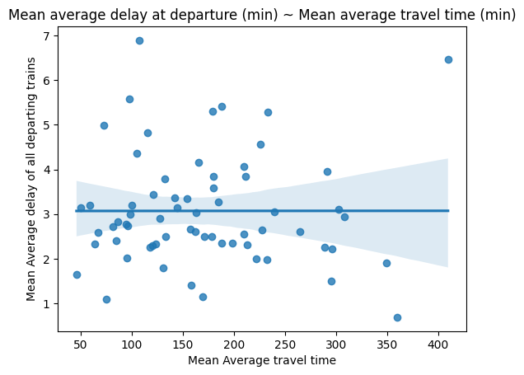
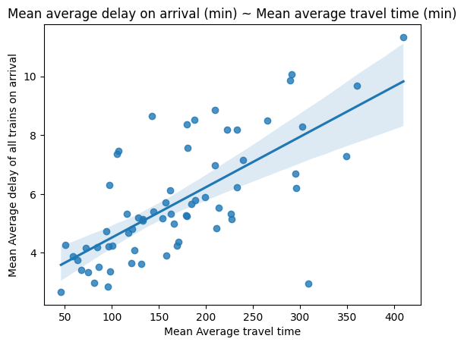
delay on ARRIVAL is highly related to average travel of time
Setting average travel time as predictor and mean delay at departure/on arrival as dependent variable, regression line is almost horizontal for the departure case, while having a positive slope in the arrival case.
By running ANOVA test, the p-value is 9.76*10⁻¹¹ for the regression result the arrival case. It shows statistical significance and tells us the longer a train trip is, the longer it might be delayed when arriving. On the other hand, the p-value is 0.996 for the departure case. That means it’s almost certainly that the distribution is random (by a probability of 99.6%)! Travel time has nothing to do with delay duration at departure

Slide 20
Delay causes definitions
External causes: weather, obstacles, suspicious packages, malevolence, social movements
Railway infrastructure: maintenance, works
Traffic management: rail line traffic, network interaction
Rolling stock: all the powered and non-powered carts on the railway
Station management and reuse of equipment
Passenger consideration: crowds, connections

Slide 21
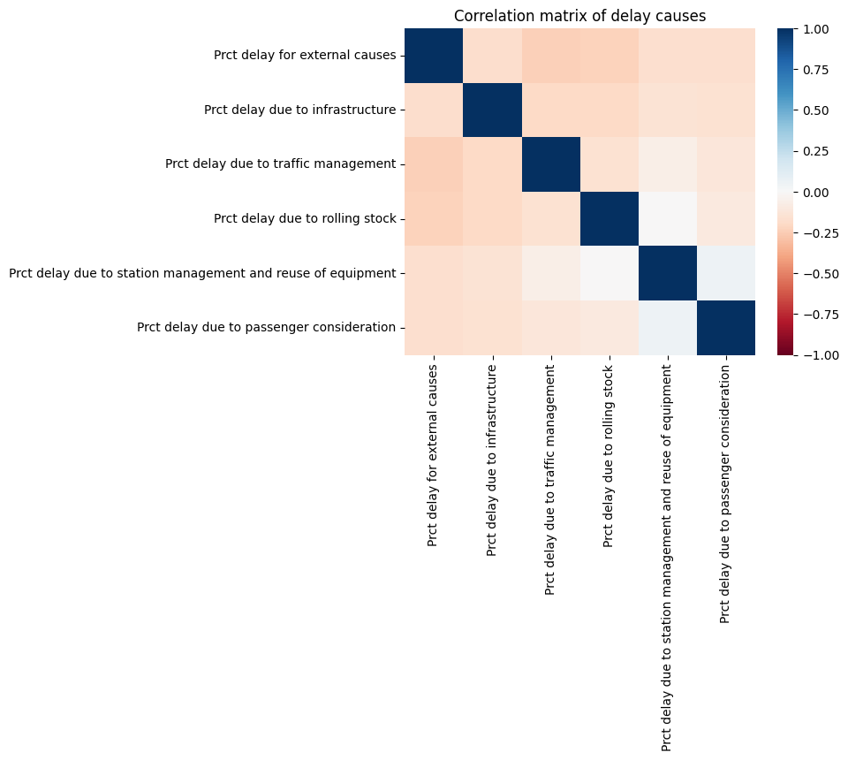
Delay cause Does not seem to correlate
Minimal correlations among different delay causes
Correlation value among different delay causes are almost all negative
The slightly more correlated pairs are external causes to traffic management and external causes to rolling stock (valued around -0.25)

Slide 22
Findings summary
The strikes and pandemic decreases the number of trains, but not necessarily punctuality
One in 2 trains will be delayed at departure in June, while only 1 in 10 on arrival in April
Departure punctuality dwindles in pandemic, while arrival punctuality improves
Smaller percentage of trains is delayed for a certain duration in pandemic
Train operation in lockdown is more punctual than non-lockdown period during pandemic
No relationship between number of scheduled trains and percentage of delayed trains
No relationship between travel time and percentage of delayed trains
Positive relationship exists between travel time and average delay of trains on arrival
Changes to natural elements and traveler volumes affect the main cause of delay
Little to none correlations among different causes of delay

Slide 23
If there is more time…
Deeper analysis in different causes of delay
What causes of delay affect trains the most in terms of delay duration? (causes vs. delayed trains > mins)
What cause of delay have the highest percentage in pandemic?
Route specific analysis
Which routes are affected the most by the external causes of delay? Could it be due to being in regions prone to harsh weather or frequent strikes?
Prediction of percentage of delayed trains given a specific month, number of scheduled, travel time, and proportions of different causes of delay
Via scikit-learn, Using supervised learning with percentage of delayed trains as labels to train and predict

Slide 24
Thank you
Je-Ching Liao​
MS in Data Science Graduate Student
University of Michigan
734 489 2764
jeching@umich.edu

